Slide 1

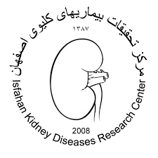
Osteoporosis Post transplant
به نام خداوند جان و خرد
Dr. Shahrzad Shahidi
Professor of Nephrology
Isfahan University of Medical Sciences

Slide 2
Case
55-y.o. male, 9 months following successful KTx.
Routine DEXA demonstrated a T-score of –2.6 at the femoral neck.
He is on low-dose prednisone, tacrolimus, & MMF. In addition, he uses vit D supplements.
  PTH: 140 pg/mL (15-65)
  Ca: 8.8 mg/dL
  Ph: 3.0 mg/dL

Slide 3
Case
What would you do next?
  Initiate bisphosphonate therapy
  Refer for subtotal parathyroidectomy
  Wait & see as appropriate
  Lower the dose of prednisone
Notes:
Correct. After kidney transplantation, fracture risk is high especially with low BMD score. In general, treatment can be as for the general population.
Persistent hyperparathyroidism can resolve completely after 12-18 months following kidney transplantation. Frequently, a slightly increased PTH persists which, in the absence of hypercalcemia, is of uncertain clinical implication.
In kidney transplant recipients (KTR) DEXA result predicts fracture risk. In addition, risk in KTR is usually increased due to persistent bone disease and use of steroids; therefore, this patient is at risk for incident fractures. Fall prevention and pharmacotherapy to raise BMD is appropriate.
In the last decades, the cumulative dose of steroids after kidney transplantation has declined. This patient currently is using low-dose prednisone, combined with low doses of CNI and MMF. Further lowering of prednisone may increase the risk of rejection.

Slide 4
Introduction
The major bone diseases that affect KTRs are:
  Osteoporosis
  Osteonecrosis (AVN),
both of which cause significant long-term morbidity.
Osteoporosis increases the risk of fractures.

Slide 5
Introduction
Falls are the leading cause of both fatal & nonfatal injuries in people aged ≥ 65

Slide 6
Introduction
iPTH typically remains normal until the eGFR decreases to ≠ 45 mL/min/1.73 m²
Calcitriol level started to fall until eGFR was < 40 mL/min/1.73 m²
Hsu CY. Int J Mol Sci.2020

Slide 7

Epidemiology
The risk of Fx in patients with organ transplants is very high (particularly during the early phase after the surgery):
  Almost 5 times & 20 times higher in male & female KTRs compared with age- & sex-matched control groups.
  The risk is particularly high in perimenopausal women.
  Fx seemed to occur frequently at an appendicular bone in KTRs
The long-term risk of Fx based on a 15-y observational study was ~60%, which was almost 3 times higher than the expected risk.
Kim SM. Medscape.2022

Slide 8
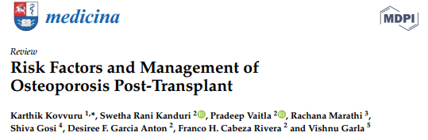
Kovvuru K. Medicine. 2020

Slide 9
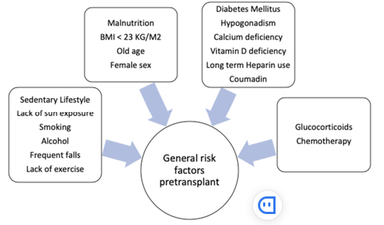
General risk factors for osteoporosis
Kovvuru K. Medicine. 2020

Slide 10
Major risk factors for OP in KTRs
Glucocorticoids
CNIs
Persistent hyperparathyroidism
Hsu CY. Int J Mol Sci.2020

Slide 11
Major risk factors for OP in KTRs
Glucocorticoids – Among transplant recipients, GC-induced suppression of bone formation is the most important risk factor for bone loss.
  GCs are directly toxic to osteoblasts & lead to increased osteoclast activity.
  Decreased Ca absorption in the gut
  Reduced gonadal hormone production
  Diminished insulin-like growth factor 1 production
  Decreased sensitivity to PTH
  Increased activity of RANKL
  Increased osteoclastogenesis
The lower rates of bone loss following KT documented in recent years may reflect the lower doses of GCs used to treat these patients.
Hsu CY. Int J Mol Sci.2020

Slide 12
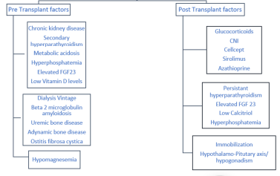
Pre & post-transplant risk factors associated with post KT osteoporosis
Kovvuru K. Medicine. 2020

Slide 13
Diagnosis

Slide 14
Evaluation of Bone Strength
DXA evaluates the bone quantity & not the bone quality.
Non-invasive 3D imaging techniques that can detect microarchitecture & mineral density of both trabecular & cortical bones
  Peripheral quantitative CT (pQCT)
  High resolution pQCT (HRpQCT)
  micromagnetic resonance imaging (microMRI)
However, there are few data in evaluating these techniques in patients with CKD.
Hsu CY. Int J Mol Sci.2020
Notes:
Dual-energy X-ray absorptiometry

Slide 15
Trabecular bone score (TBS)
TBS indirectly analyzes trabecular bone microarchitecture, may add further insight in Fx assessment.

Slide 16
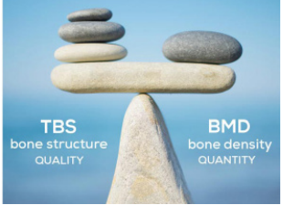

Slide 17
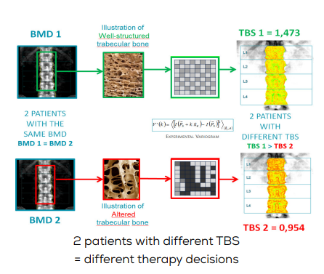

Slide 18
TBS
TBS’ maximum impact is observed in patients with osteopenic/normal BMD values who display low TBS scores & consequently have a higher combined risk of Fx or in patients whose Fx risk is close to the intervention threshold.
TBS helps doctors identify patients at risk of Fx due to secondary OP caused by such as OA, DM, Endocrine diseases, GCs, CKD, Breast Cancer patients treated with Aromatase Inhibitors, etc.
Notes:
OA= Osteoarthritis

Slide 19
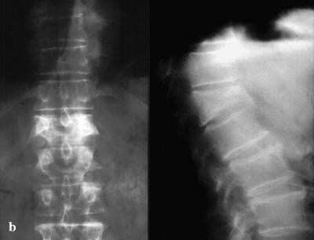
Anteroposterior & lateral radiographs of an L1 osteoporotic wedge compression Fx
Kim SM. Medscape.2022

Slide 20
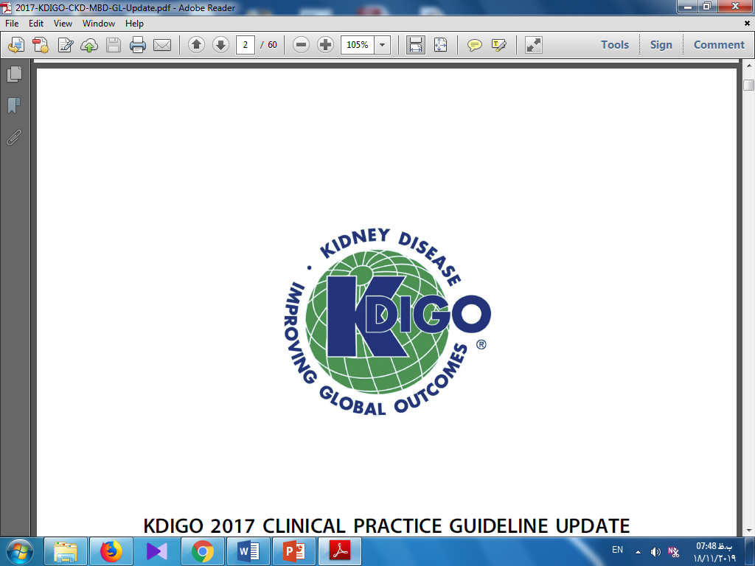
KDIGO 2017 Update for CKD-MBD
5.1: In patients in the immediate post–KTx period, we recommend measuring serum Ca & ph at least weekly, until stable (1B).
5.2: In patients after the immediate post–KTx period, it is reasonable to base the frequency of monitoring serum Ca, Ph, & PTH on the presence & magnitude of abnormalities, & the rate of progression of CKD (Not Graded).

Slide 21
KDIGO 2017 Update for CKD-MBD
PTH | Ca & Ph | CKD Stage
once, with subsequent intervals depending on baseline level & CKD progression | 6–12 ms | G1T- G3bT
6-12 ms | 3-6 ms | G4T
3-6 ms | 1-3 ms | G5T

Slide 22
KDIGO 2017 Update for CKD-MBD
In CKD patients receiving treatments for CKD-MBD, or in whom biochemical abnormalities are identified, it is reasonable to increase the frequency of measurements to monitor for efficacy & side effects (Not Graded).
It is reasonable to manage these abnormalities as for patients with CKD G3a–G5 (Not Graded).

Slide 23
KDIGO 2017 Update for CKD-MBD
5.5: In patients with CKD G1T–G5T with risk factors for osteoporosis, we suggest that BMD testing be used to assess Fx risk if results will alter therapy (2C).

Slide 24
BMD
DEXA scans are recommended at the time of Tx & 1 & 2 years following Tx.
Parenteral bisphosphonate should be considered when the BMD T-score is less than or equal to –2 SD.
Kim SM. Medscape.2022

Slide 25
Management

Slide 26
Prevention of osteoporosis
Encourage lifestyle changes
Maintain the lowest possible GC dose
Treat with Calcium & vit D3
  Ca intake of 1000 mg/day, preferably from food
  Target serum 25 OH vit D level of >30 ng/mL
Treat persistent hyperparathyroidism

Slide 27
LIFESTYLE MEASURES
Including:
  Adequate Ca & vit D intake
  Exercise
  Cessation of smoking
  Avoiding excessive alcohol intake
  Fall prevention

Slide 28
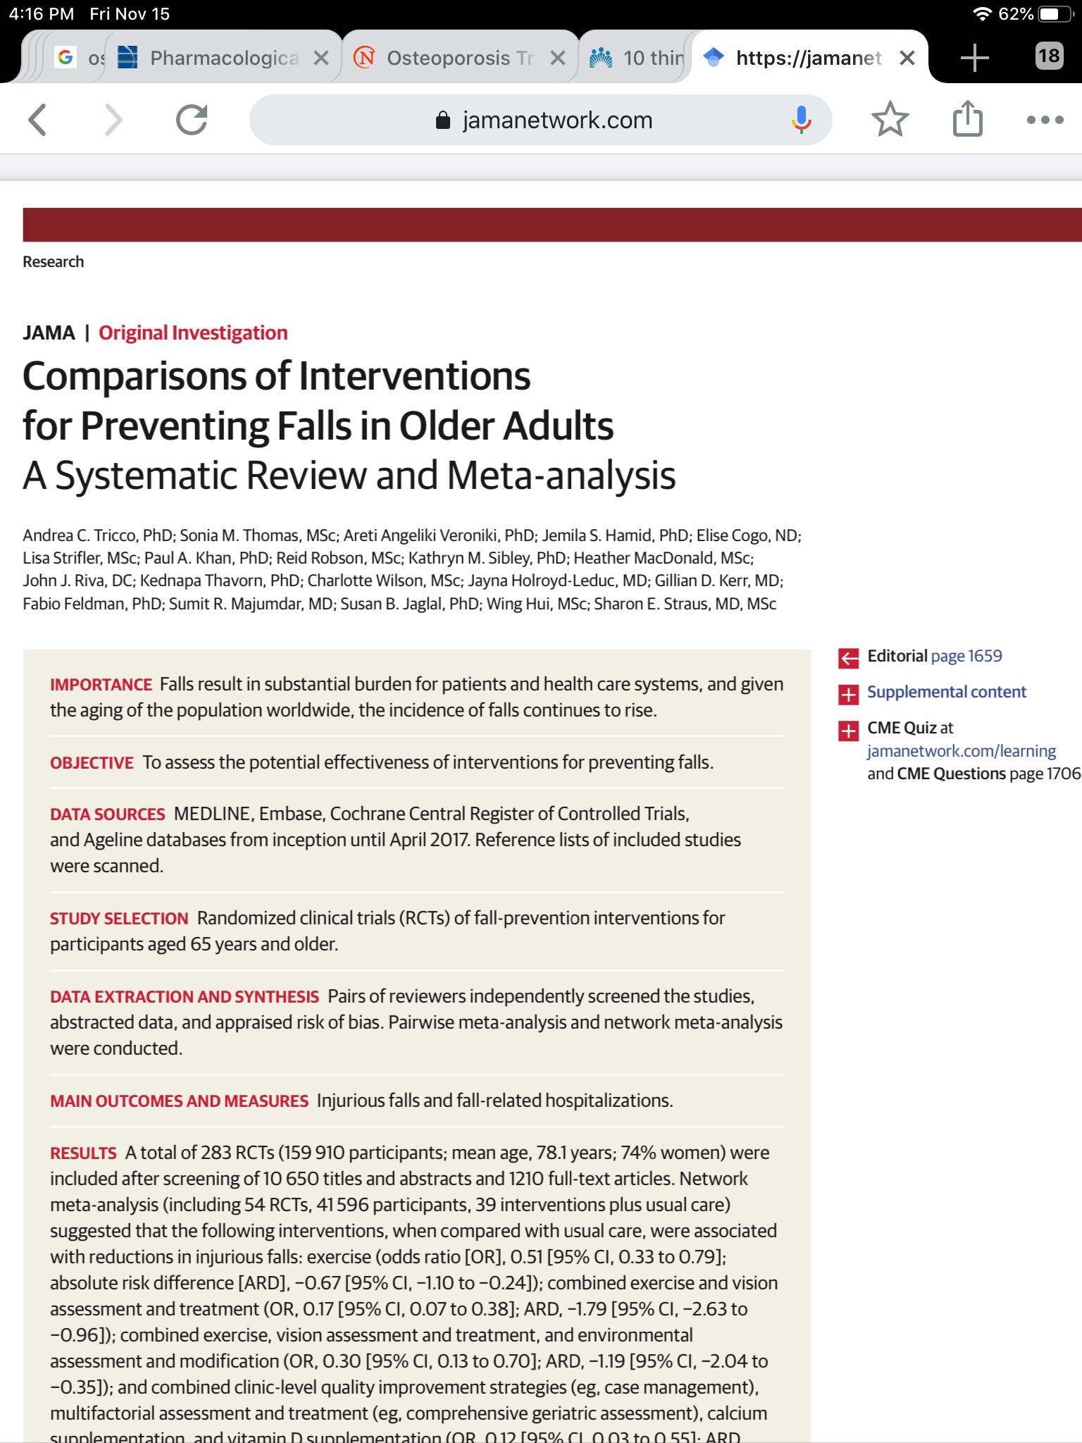
Tricco AC. 2017. JAMA

Slide 29
What type of fall-prevention programs may be effective for reducing injurious falls in older people?
In a network met-analysis including 54 studies & 41 596 participants:
  Exercise (OR, 0.51)
  Combined exercise, vision assessment & treatment, & environmental assessment & modification (OR, 0.30)
  Combined exercise, & vision assessment & treatment (OR, 0.17)
  Combined clinic-level quality-improvement strategies, multifactorial assessment and treatment, Ca & vit D supplementation (OR, 0.12)
  were significantly associated with reductions in injurious falls.
Combinations of interventions likely to be more effective than usual care for preventing injurious falls.
Tricco AC. 2017. JAMA

Slide 30
What type of fall-prevention programs may be effective for reducing injurious falls in older people?
Be physically active.
Check your vision.
Wear proper shoes or slippers.
Check your medications—especially sleeping pills.
Be safe in the bathroom.
Get the right equipment.
Avoid too much alcohol.
Eliminate household hazards.
Consider vit D.
Talk to your health care team about your risk.
Tricco AC. 2017. JAMA

Slide 31
KDIGO 2017 Update for CKD-MBD
5.3: In patients with CKD G1T–G5T, we suggest that 25(OH)D levels might be measured, & repeated testing determined by baseline values & interventions (2C).
5.4: In patients with CKD G1T–G5T, we suggest that vit D deficiency & insufficiency be corrected using treatment strategies recommended for the general population (2C).

Slide 32
KDIGO 2017 Update for CKD-MBD
5.6: In patients in the first 12 ms after KT with an eGFR > approximately 30 ml/min/1.73 m² & low BMD, we suggest that treatment with vit D, calcitriol/alfacalcidol, &/or antiresorptive agents be considered (2D).

Slide 33
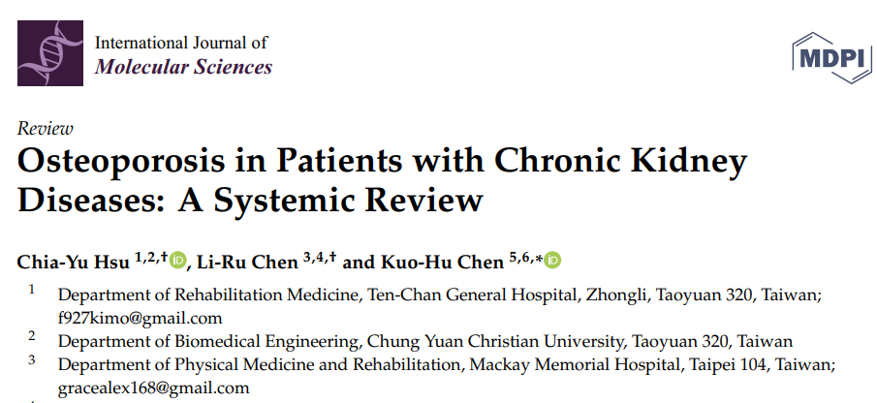
IF: 6.208
Hsu CY. Int J Mol Sci.2020

Slide 34
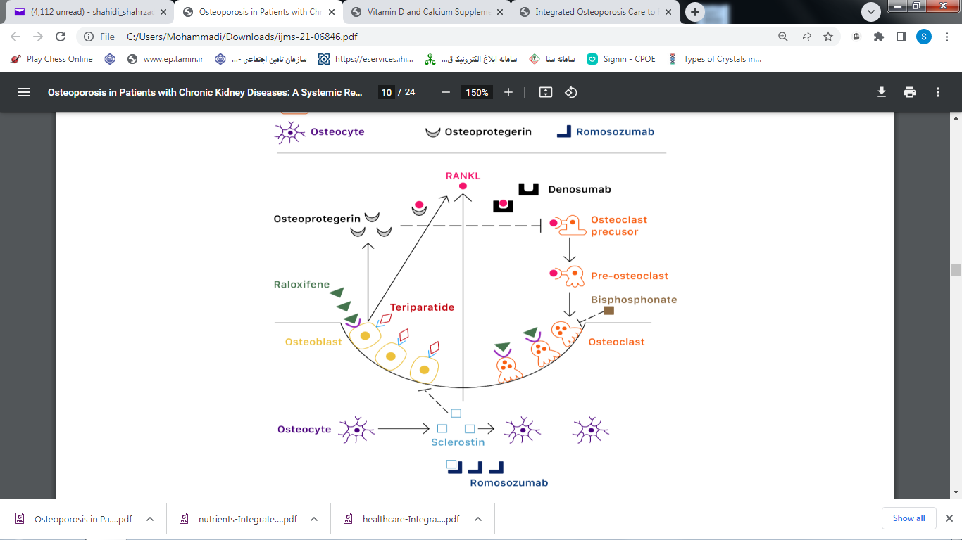
Hsu CY. Int J Mol Sci.2020
Notes:
Normally bone is continuously renewed through bone formation by osteoblasts & bone resorption by osteoclasts. Osteoblasts secret receptor activator of NF-κB ligand (RANK-L) and osteoprotegerin, which are main factors of bone remodeling. RANK-L stimulate the differentiation of osteoclast precusors and pre-osteoclasts through RANK-L and M-CSF receptors.
Osteoprotegerin is a soluble combining inhibitor of RANK-L, which could reduce osteoclasts differentiation. Osteocytes secret sclerostin, which could reduce osteoblastogenesis and stimulate osteoclastogenesis by inducing RANK-L synthesis. Bisphosphonates have high affinity to hydroxyapatite and selectively inhibit farnesyl pyrophosphate synthase within osteoclasts and induce osteoclast apoptosis. Raloxifene is a selective estrogen receptor modulator and could enhance osteoclast apoptosis . Intermittent administration of teriparatide could stimulate bone formation through the PTH-1 receptor expressed only in osteoblasts. Denosumab targets RANK-L, leading to suppression of osteoclasts differentiation. Romosozumab binds sclerostin, leading to both osteoblast activation and reduced osteoclastogenesis.

Slide 35
KDIGO 2017 Update for CKD-MBD
5.6(con):We suggest that treatment choices be influenced by the presence of CKD-MBD, as indicated by abnormal levels of Ca, Ph, PTH, Alp, & 25(OH)D (2C).
It is reasonable to consider a bone biopsy to guide treatment (Not Graded).
There are insufficient data to guide treatment after the first 12 ms.

Slide 36
KDIGO 2017 Update for CKD-MBD
5.7: In patients with CKD G4T–G5T with known low BMD, we suggest management as for patients with CKD G4–G5 not on dialysis (2C).

Slide 37
KDIGO 2017 Update for CKD-MBD
Cinacalcet is not approved for the treatment of hyperparathyroidism in KTRs; however, it is clinically used, especially in patients with significant hypercalcemia.
While efficiently correcting hypercalcemia, cinacalcet so far has failed to show a beneficial impact on bone mineralization in the transplant population.

Slide 38
KDIGO 2017 Update for CKD-MBD
Bisphosphonate & Denosumab are the most widely used antiresorptive agents for osteoporosis.
The amount of bisphosphonate retained in the skeleton is likely a function of:
  The baseline remodeling space
  The chronic rate of bone turnover
  The GFR.

Slide 39
KDIGO 2017 Update for CKD-MBD
Approximately 50% of the absorbed dose of oral & IV bisphosphonates is excreted by the kidney.
Oral bisphosphonates have never been shown to have renal toxicity, while IV bisphosphonates, especially Zolindronic acid, may acutely reduce GFR via a tubular lesions that mimics ATN.

Slide 40
Inhibition of Metaphysial Bone Resorption In vivo by Bisphosphonate
Anti-resorptive potency | Examples | Chemical Modification
1 10 | Etidronate Clodronate | First generation: short alkyl
10 100 100-1000 | Tiludronate Pamidronate Alendronate | Second generation: NH2-terminal group
1000-10000 1000-10000 100000 | Risedronate Ibandronate Zolendronate | Third generation: cyclic side chain
Endocrinolo Metab Clin North Am. 1998;27.

Slide 41
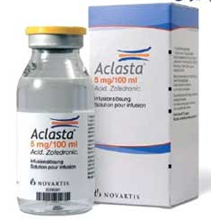
Bisphosphonates
They have a high affinity for bone mineral,& therefore, they are typically retained in the skeleton for several years.
Over the past decade, data suggest that these agents are safe in patients with an eGFR of 15-59 ml/min/1.73m².
Clin J Am Soc Neph. 2018;13(6): 962-060

Slide 42
Bisphosphonates
Should not be used routinely in patients with an eGFR < 30 ml/min & should only be considered in such patients by clinicians with expertise in MBD & after excluding ROD.

Slide 43
Bisphosphonates
If an antiresorptive agent such as a bisphosphonate is used, significant increases in spine BMD may be observed within 1 year.
An increase in femoral neck BMD may not be seen until after an average of 4-5 years & probably longer with weaker antiresorptive agents.
Kim SM. Medscape.2022

Slide 44
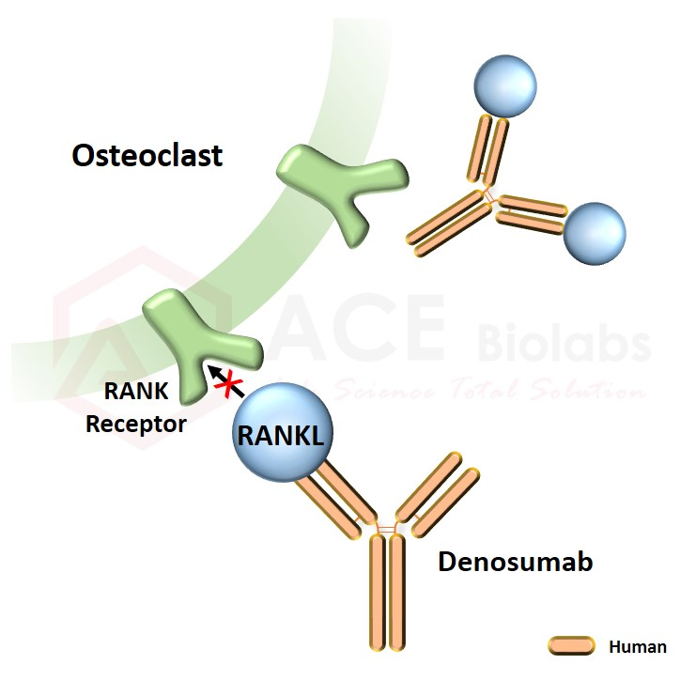
Denosumab
Is a monoclonal antibody that is directed against RANK ligand & inhibits osteoclast proliferation & development.
60 mg/6 ms SQ.
Inter Med. 2017;56

Slide 45
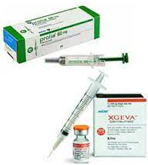
Denosumab
Is effective at reducing the fx risk & the efficacy is not influenced by the kidney function.
This agent is liable to cause hypocalcemia in patients with an impaired renal function.
Inter Med. 2017;56

Slide 46
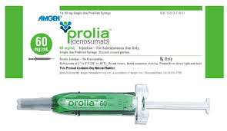
Denosumab
Hypocalcemia induced by denosumab should be avoided by practicing appropriate precaution & preemptively administering active vit D to eligible CKD patients before starting denosumab.
The serum Ca levels usually reach their nadir around 7 days after administration, with a less-extensive Ca decrease
with the second denosumab
administration.
Inter Med. 2017;56

Slide 47
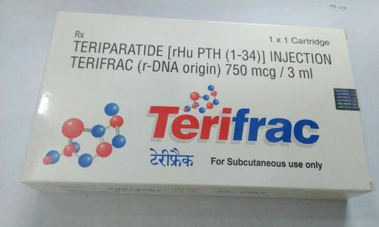
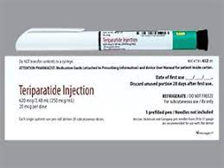
Teriparatide (rhPTH)
20 µg/day SQ for 18-24 ms.
Potential for serum Ca elevation.
Inter Med. 2017;56

Slide 48
Teriparatide (rhPTH)
Some authors use teriparatide in patients who:
  Develop fragility Fxs while receiving bisphosphonates or denosumab as preventive therapy
  As first-line therapy in patients who are at high risk for fractures if bone turnover is demonstrated to be low by bone turnover markers or bone biopsy.
After stopping teriparatide, antiresorptive therapy may be considered if the patient's bone turnover is expected to rebound.

Slide 49
Abaloparatide
Is an analog of PTHrp.
Is more purely anabolic with approximately 50% lower risk of hypercalcemia.
Clin J Am Soc Neph. 2018;13(6): 962-060

Slide 50
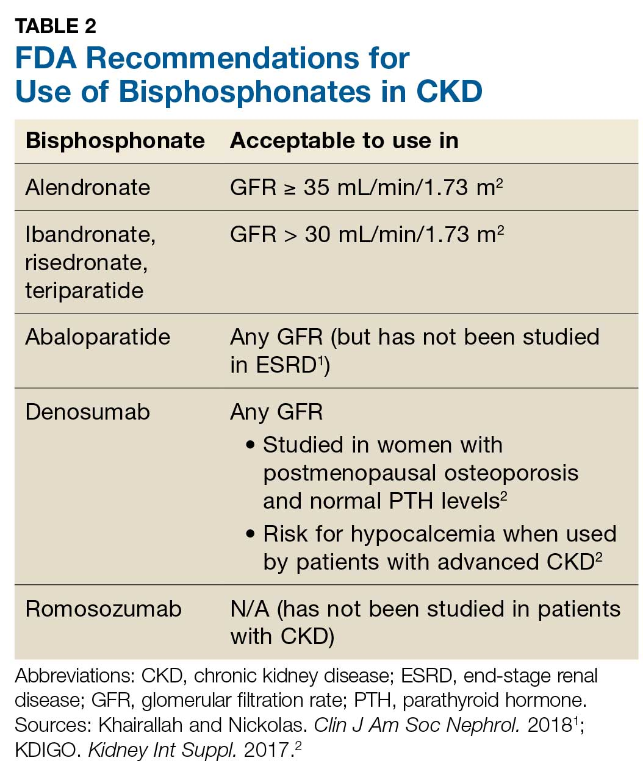

Slide 51
Case
55-y.o. male, 9 months following successful KTx.
Routine DEXA demonstrated a T-score of –2.6 at the femoral neck.
He is on low-dose prednisone, tacrolimus, & MMF. In addition, he uses vit D supplements.
  PTH: 140 pg/mL (15-65)
  Ca: 8.8 mg/dL
  Ph: 3.0 mg/dL

Slide 52
Case
What would you do next?
  Initiate bisphosphonate therapy
  Refer for subtotal parathyroidectomy
  Wait & see as appropriate
  Lower the dose of prednisone
Notes:
Correct. After kidney transplantation, fracture risk is high especially with low BMD score. In general, treatment can be as for the general population.
Persistent hyperparathyroidism can resolve completely after 12-18 months following kidney transplantation. Frequently, a slightly increased PTH persists which, in the absence of hypercalcemia, is of uncertain clinical implication.
In kidney transplant recipients (KTR) DEXA result predicts fracture risk. In addition, risk in KTR is usually increased due to persistent bone disease and use of steroids; therefore, this patient is at risk for incident fractures. Fall prevention and pharmacotherapy to raise BMD is appropriate.
In the last decades, the cumulative dose of steroids after kidney transplantation has declined. This patient currently is using low-dose prednisone, combined with low doses of CNI and MMF. Further lowering of prednisone may increase the risk of rejection.

Slide 53
Case
What would you do next?
  Initiate bisphosphonate therapy
  Refer for subtotal parathyroidectomy
  Wait & see as appropriate
  Lower the dose of prednisone
Notes:
Correct. After kidney transplantation, fracture risk is high especially with low BMD score. In general, treatment can be as for the general population.
Persistent hyperparathyroidism can resolve completely after 12-18 months following kidney transplantation. Frequently, a slightly increased PTH persists which, in the absence of hypercalcemia, is of uncertain clinical implication.
In kidney transplant recipients (KTR) DEXA result predicts fracture risk. In addition, risk in KTR is usually increased due to persistent bone disease and use of steroids; therefore, this patient is at risk for incident fractures. Fall prevention and pharmacotherapy to raise BMD is appropriate.
In the last decades, the cumulative dose of steroids after kidney transplantation has declined. This patient currently is using low-dose prednisone, combined with low doses of CNI and MMF. Further lowering of prednisone may increase the risk of rejection.

Slide 54





FOLLOW KDIGO
www.kdigo.org
/goKDIGO
@goKDIGO
@goKDIGO

